Slide 1
Data Curation
Team 6: Krunal Sevak (A20405875)
Parth Patel (A20405581)
Tai Nguyen (A20356881)

Slide 2
Dataset Description
City of Chicago – Crimes (1 year prior to present)
Reporting incidents of crime over the past year
17 columns / ~262,000 rows
CSV format
Issues:
NULL values
Data redundancy
No constraints verification on CSV format
Tools used:
Jupyter Notebook using R

Slide 3
Column Description
Case Name | Description
CASE# | The Chicago Police Department RD Number (Records Division Number), which is unique to the incident.
DATE OF OCCURRENCE | Date when the incident occurred. This is sometimes a best estimate.
BLOCK | The partially redacted address where the incident occurred, placing it on the same block as the actual address.
IUCR | The Illinois Uniform Crime Reporting Code.
PRIMARY DESCRIPTION | The primary description of the IUCR code.
SECONDARY DESCRIPTION | The secondary description of the IUCR code, a subcategory of the primary description.
LOCATION DESCRIPTION | Description of the location where the incident occurred.
ARREST | Indicates whether an arrest was made.
DOMESTIC | Indicates whether the incident was domestic-related as defined by the Illinois Domestic Violence Act.

Slide 4
Column Description
Case Name | Description
BEAT | Indicates the beat where the incident occurred. A beat is the smallest police geographic area - each beat has a dedicated police beat car.
WARD | The ward (City Council district) where the incident occurred.
FBI CD | Indicates the crime classification as outlined in the FBI's National Incident-Based Reporting System (NIBRS).
X COORDINATE | The x coordinate of the location where the incident occurred in State Plane Illinois East NAD 1983 projection. This location is shifted from the actual location for partial redaction but falls on the same block.
Y COORDINATE | The x coordinate of the location where the incident occurred in State Plane Illinois East NAD 1983 projection. This location is shifted from the actual location for partial redaction but falls on the same block.
LATITUDE | The latitude of the location where the incident occurred. This location is shifted from the actual location for partial redaction but falls on the same block.
LONGITUDE | The longitude of the location where the incident occurred. This location is shifted from the actual location for partial redaction but falls on the same block.
LOCATION | The location where the incident occurred in a format that allows for creation of maps and other geographic operations on this data portal. This location is shifted from the actual location for partial redaction but falls on the same block.

Slide 5
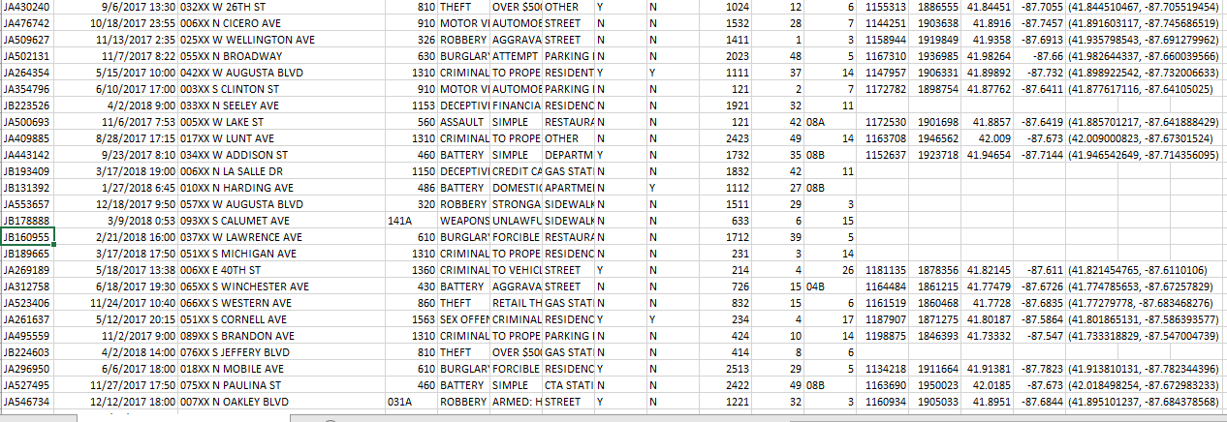
Issues
No location on rows
Solution: Replace location with the coordinate of Chicago center.

Slide 6
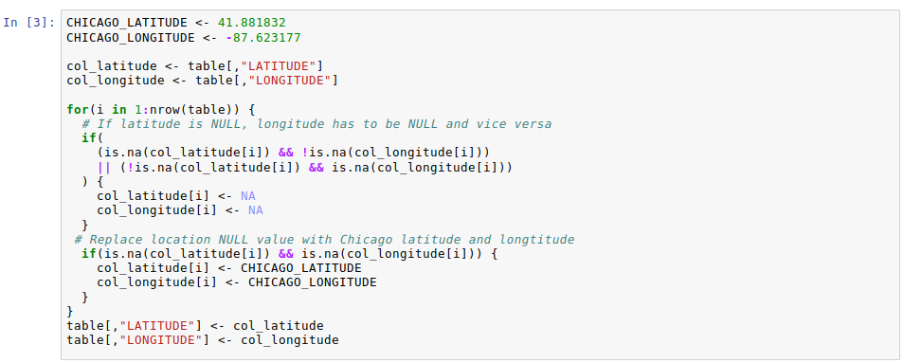
Solution

Slide 7
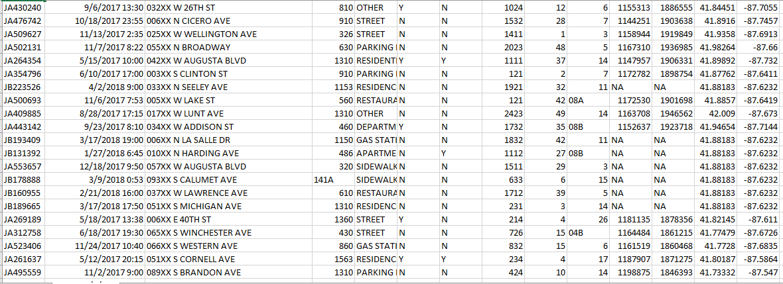
Result

Slide 8
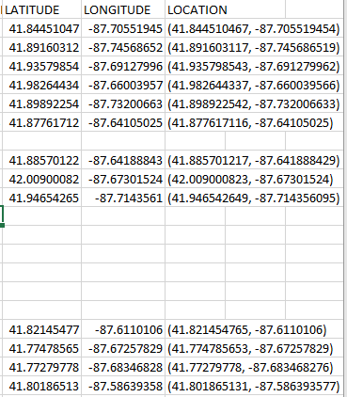
Issues
Data redundancy
Solution: Remove LOCATION column

Slide 9
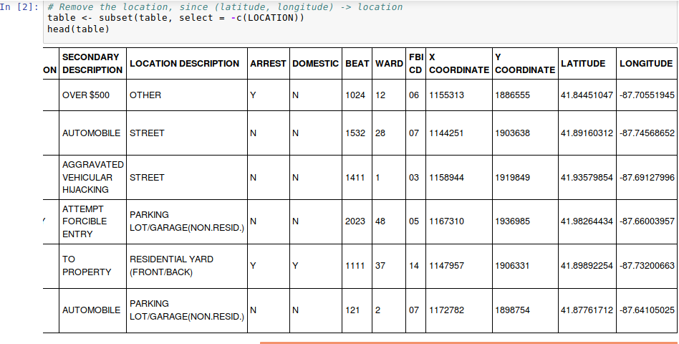
Solution

Slide 10
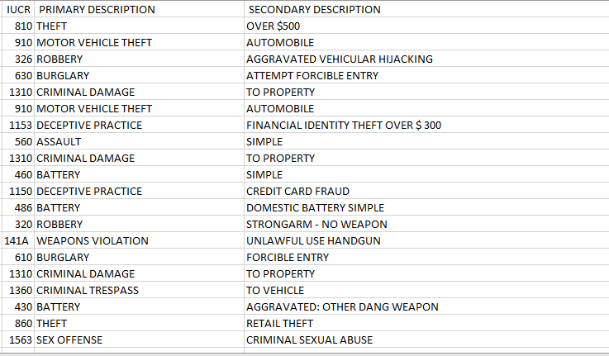
Issues
Data redundancy
Solution: Move IUCR entries into a separate dataset

Slide 11
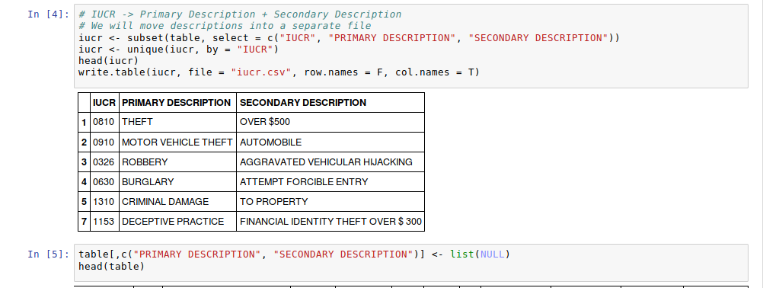
Solution

Slide 12
Data Constraint
If there exists location, both latitude and longitude must exist.

Slide 13
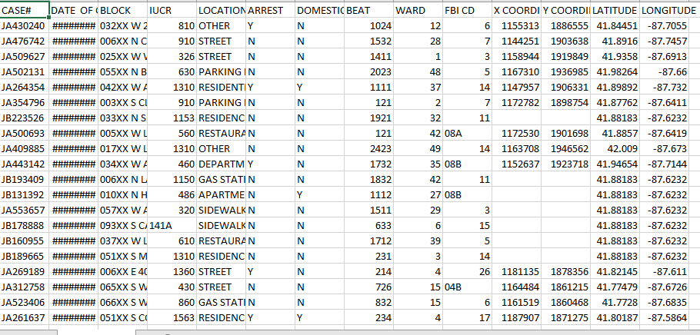
Output
cleaned_data.csv

Slide 14
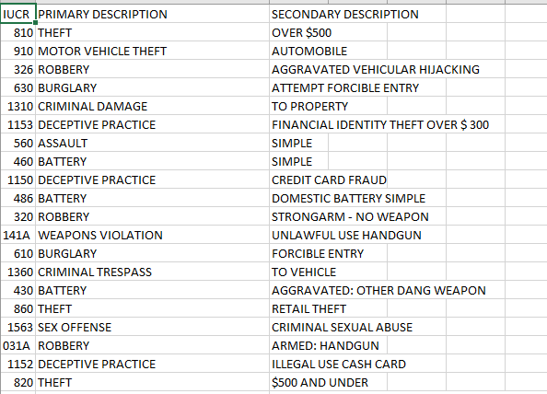
Output
iucr.csv

Slide 15
Thank you!

